Slide 1
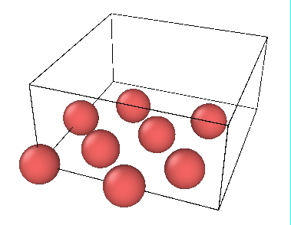
Epitaxial Growth of Silicon
Lisa Gavronskiy Dhruv Patel Joshua Stevens Mathew Maradin

Slide 2
1. Introduction

Slide 3
1.1 What is Epitaxial Growth?
“A method to grow or deposit monocrystalline films or structures on surfaces.”
Deposition
Methods
Process
Lithography
Vapour-Phase Epitaxy
Etch
Chemical Vapour Deposition
2D FCC
Epitaxial Growth
Molecular Beam Epitaxy
Annealing
[1]

Slide 4
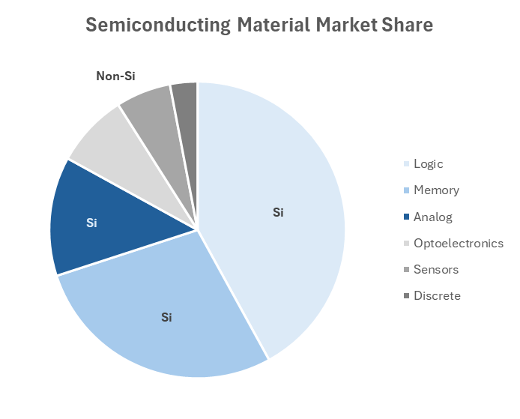
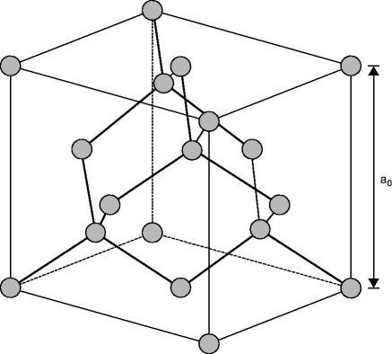
1.2 Why Silicon?
Silicon Lattice Structure
Over 83% Silicon Based
4
[2]

Slide 5
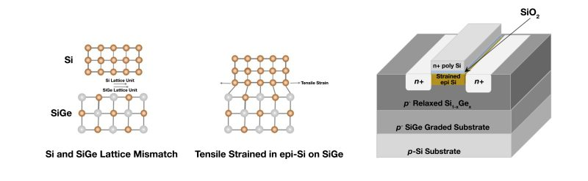
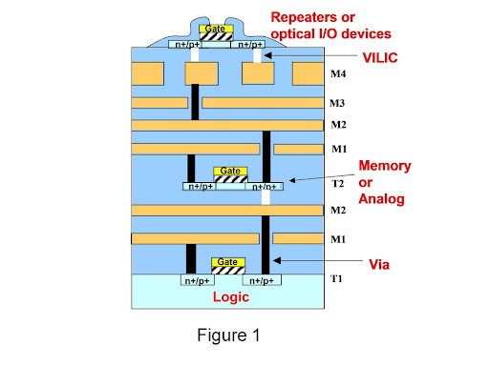
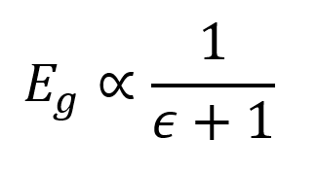
1.3 What is Epitaxy Used for?
Purposeful Lattice Mismatching
3D Monolithic
[3]

Slide 6
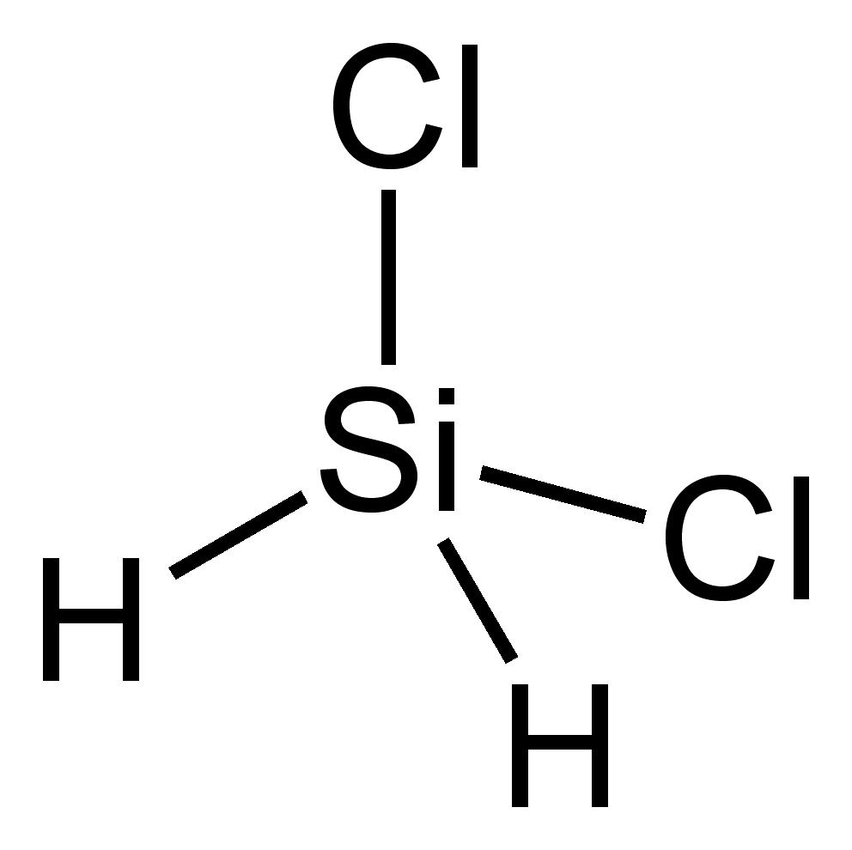
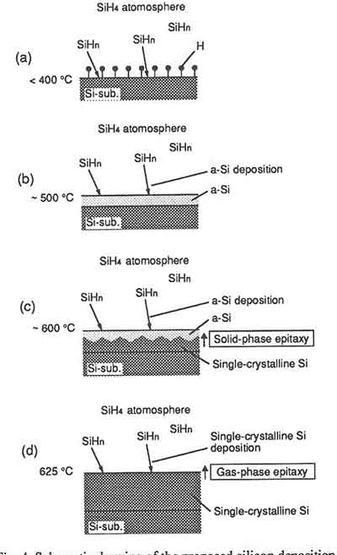
1.4 Silicon Epitaxial Growth Mechanics
400 °C
Temperature
650 °C
E Si⁴⁺ + 2HCL
DiChloroSilane
Our Focus
[4,5]

Slide 7
1.5 Simulations Overview
[6]
Step 1
Step 2
Step 3
Process
Epitaxial Growth
Equilibrium and Annealing
Visualization
Simulation Method
Kinetic Monte Carlo
Molecular Dynamics
Tool
Python
LAMMPS
OVITO & Python
Output
Crystal Lattice Initial Condition
Stress/Strain, Potential Energies

Slide 8
2. Simulation

Slide 9
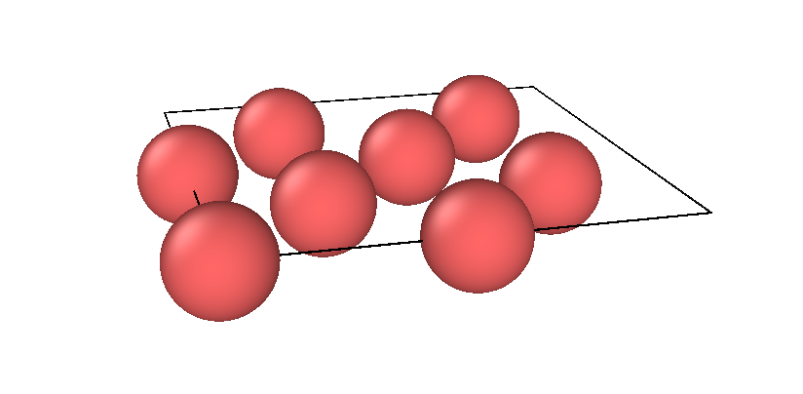
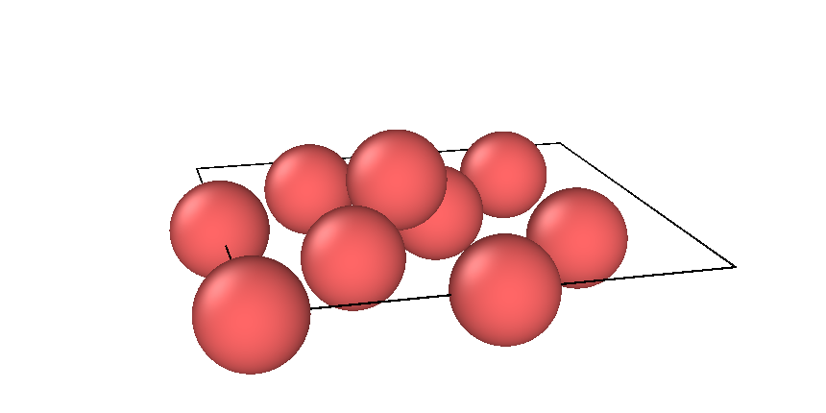
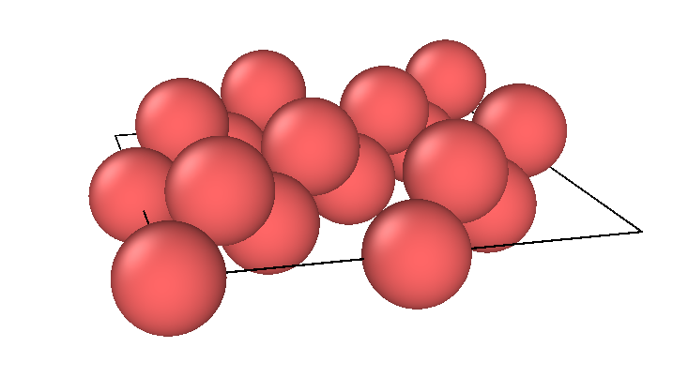
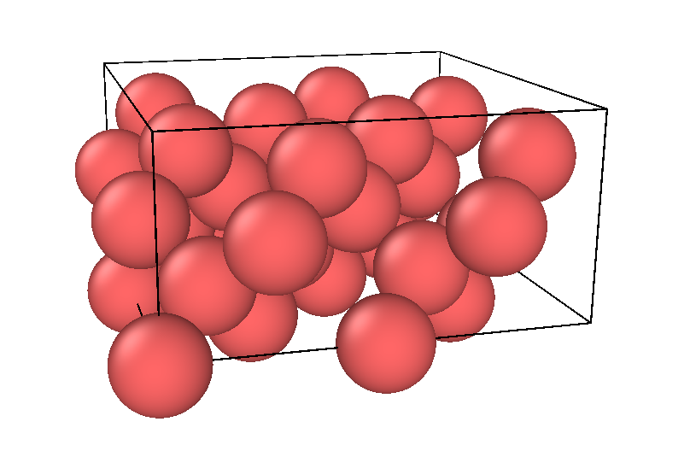
2.1 kMC Simulation Steps
bonding layer
+1 atom
+1 layer of atoms
+ layers of atoms
new layer becomes bonding layer

Slide 10
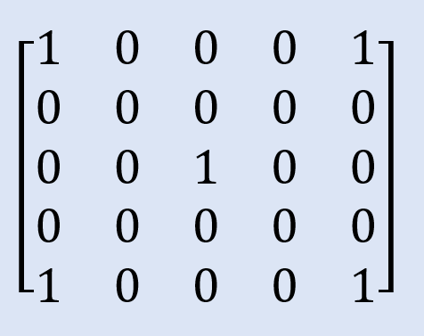
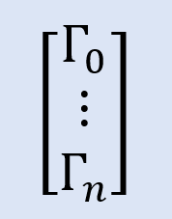
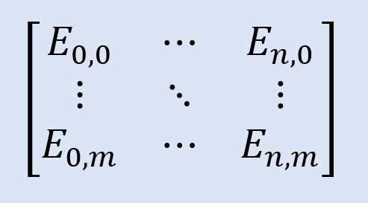
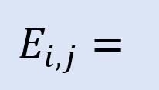
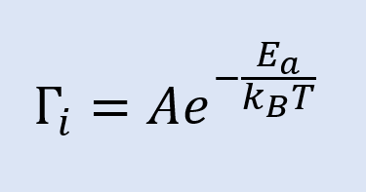
2.1.1 kMC Simulation Steps
Represent a monolayer as an array
Each site represents an event (binding) that can occur
Each event is associated with a probability proportional to its binding rate
Define a list of processes that can occur with associated rates.
1 = Atom site
0 = Free space in lattice

Slide 11
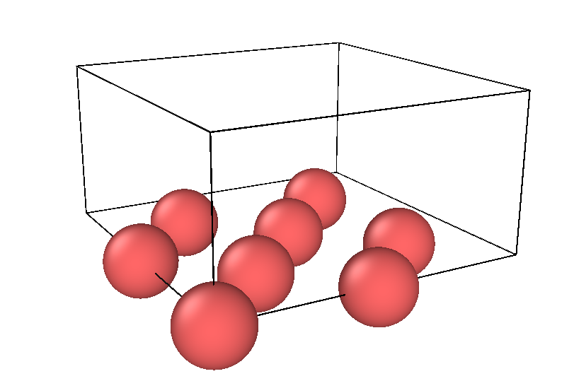
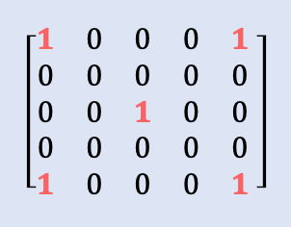
2.1.2 Diamond Lattice Implementation
Represent a monolayer as an array:
Silicon lattice structure has 4 distinct layers
Growth direction of a layer is dependent on previous layer’s configuration
Example: Layer 1 representation
(mapped using Si lattice vectors)
Si structure
Python
OVITO
[2]

Slide 12
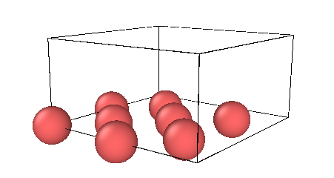
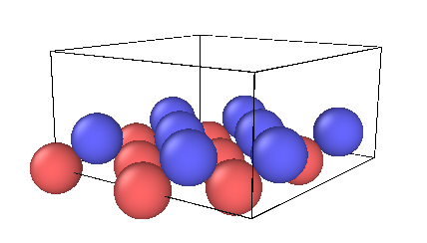
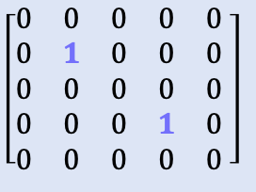
2.1.2 Diamond Lattice Implementation
Layer 1
Layer 2
[2]

Slide 13
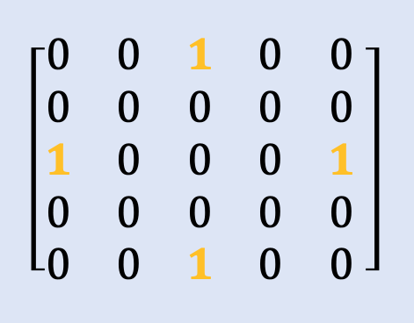
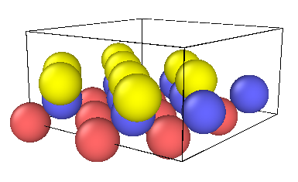
2.1.2 Diamond Lattice Implementation
Layer 2
Layer 3
[2]

Slide 14
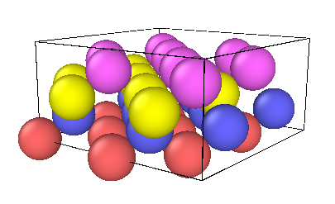
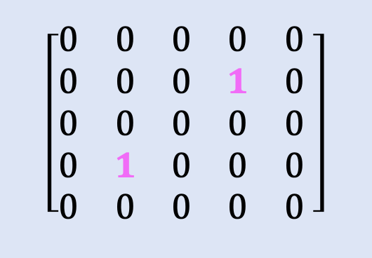
2.1.2 Diamond Lattice Implementation
Layer 3
Layer 4
[2]

Slide 15
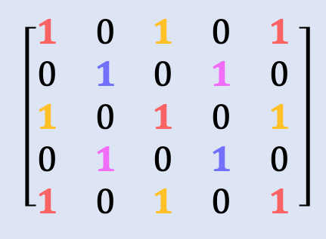
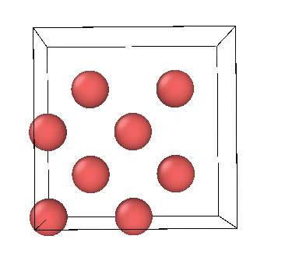
2.1.2 Diamond Lattice Implementation
Layer 1
Layer 2
Layer 3
Layer 4
…
complete Si unit cell
and
[2]

Slide 16
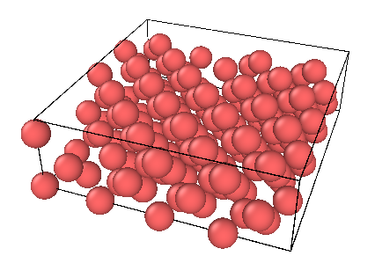
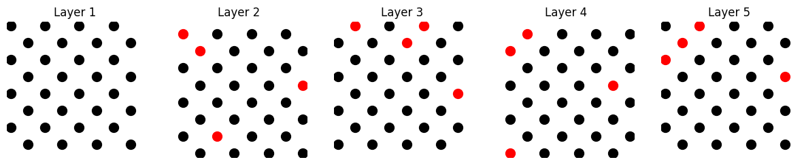
2.1.2 Diamond Lattice Implementation
Represent a monolayer as an array:
Grow each monolayer array for a n steps
n steps ≠ # of atom sites in the layer → vacancies (defects) introduced into lattice
[2]
– atom,
– vacancy (defect)

Slide 17
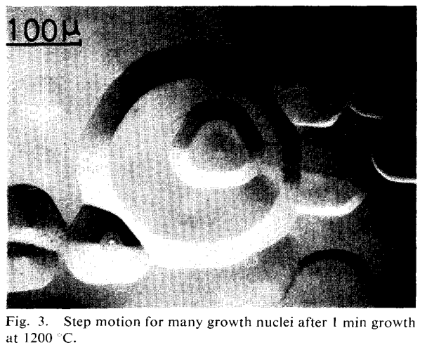
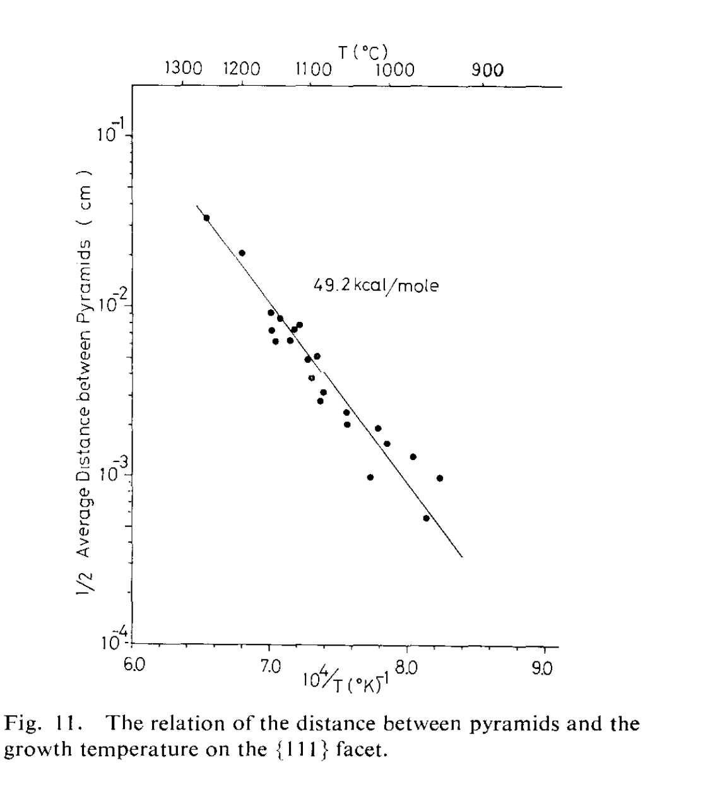
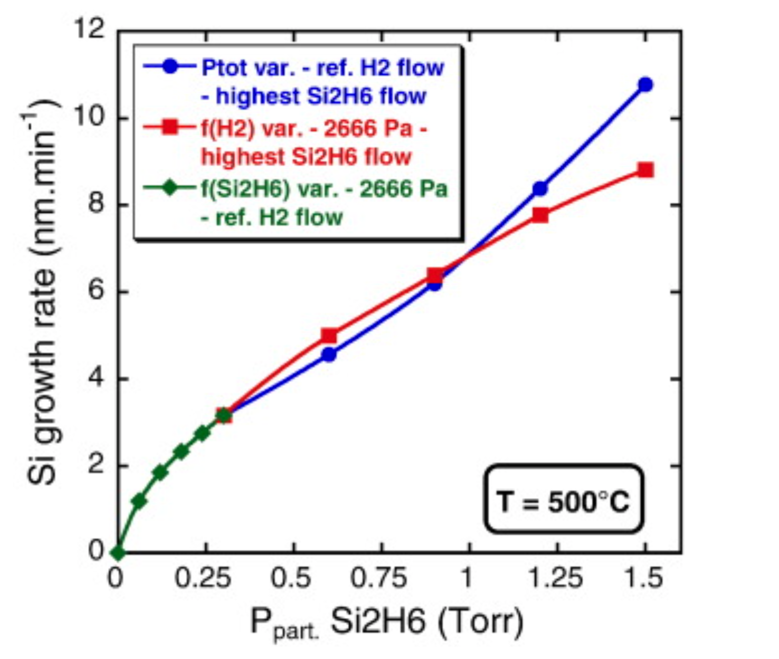

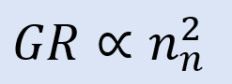
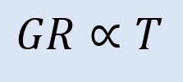
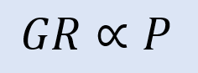
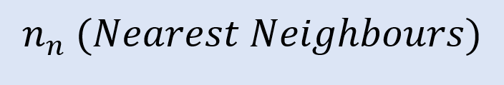
2.1.3 Arrhenius Equation Implementation
[7,8,9,10]
How to find A? (Growth Rate)

Slide 18
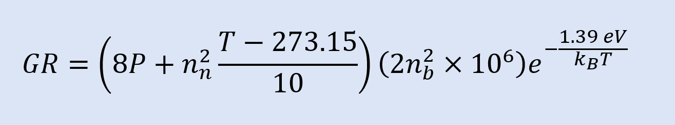
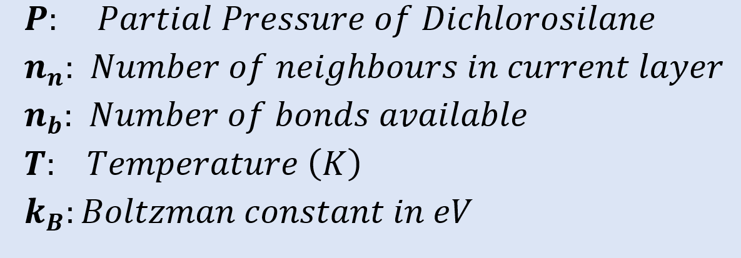
2.1.3 Arrhenius Equation cont’d

Slide 19
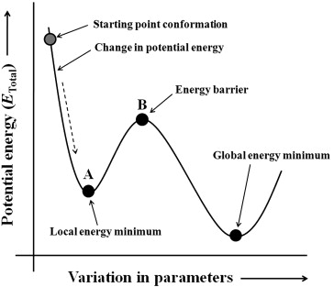
2.2 Molecular Dynamics
Output of crystal lattice structure using kMC
Convert atom positions to input for LAMMPS
Use LAMMPS to equilibrate the system for an NPT ensemble
Find most relaxed state of the system
Lattice with defects won’t sit in the same position as a ‘perfect’ crystal lattice
→ volume of lattice will change!
LAMMPS
goal
[12]

Slide 20
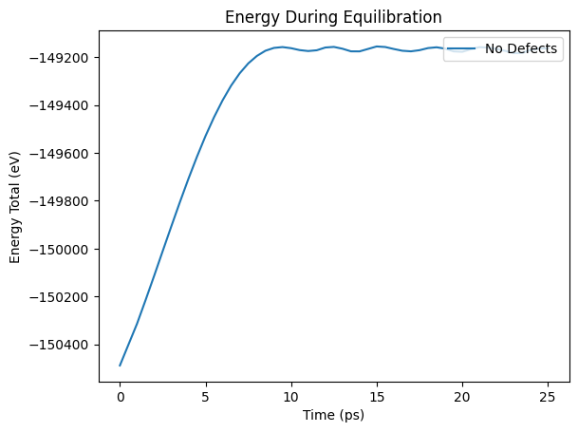
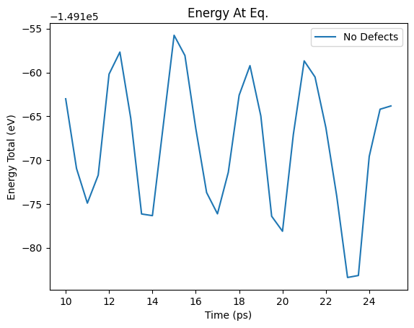
2.2 Molecular Dynamics
Use LAMMPS to equilibrate the system for an NPT ensemble
oscillations become stable after 10 ps -> system reached equilibrium

Slide 21
3. Results

Slide 22
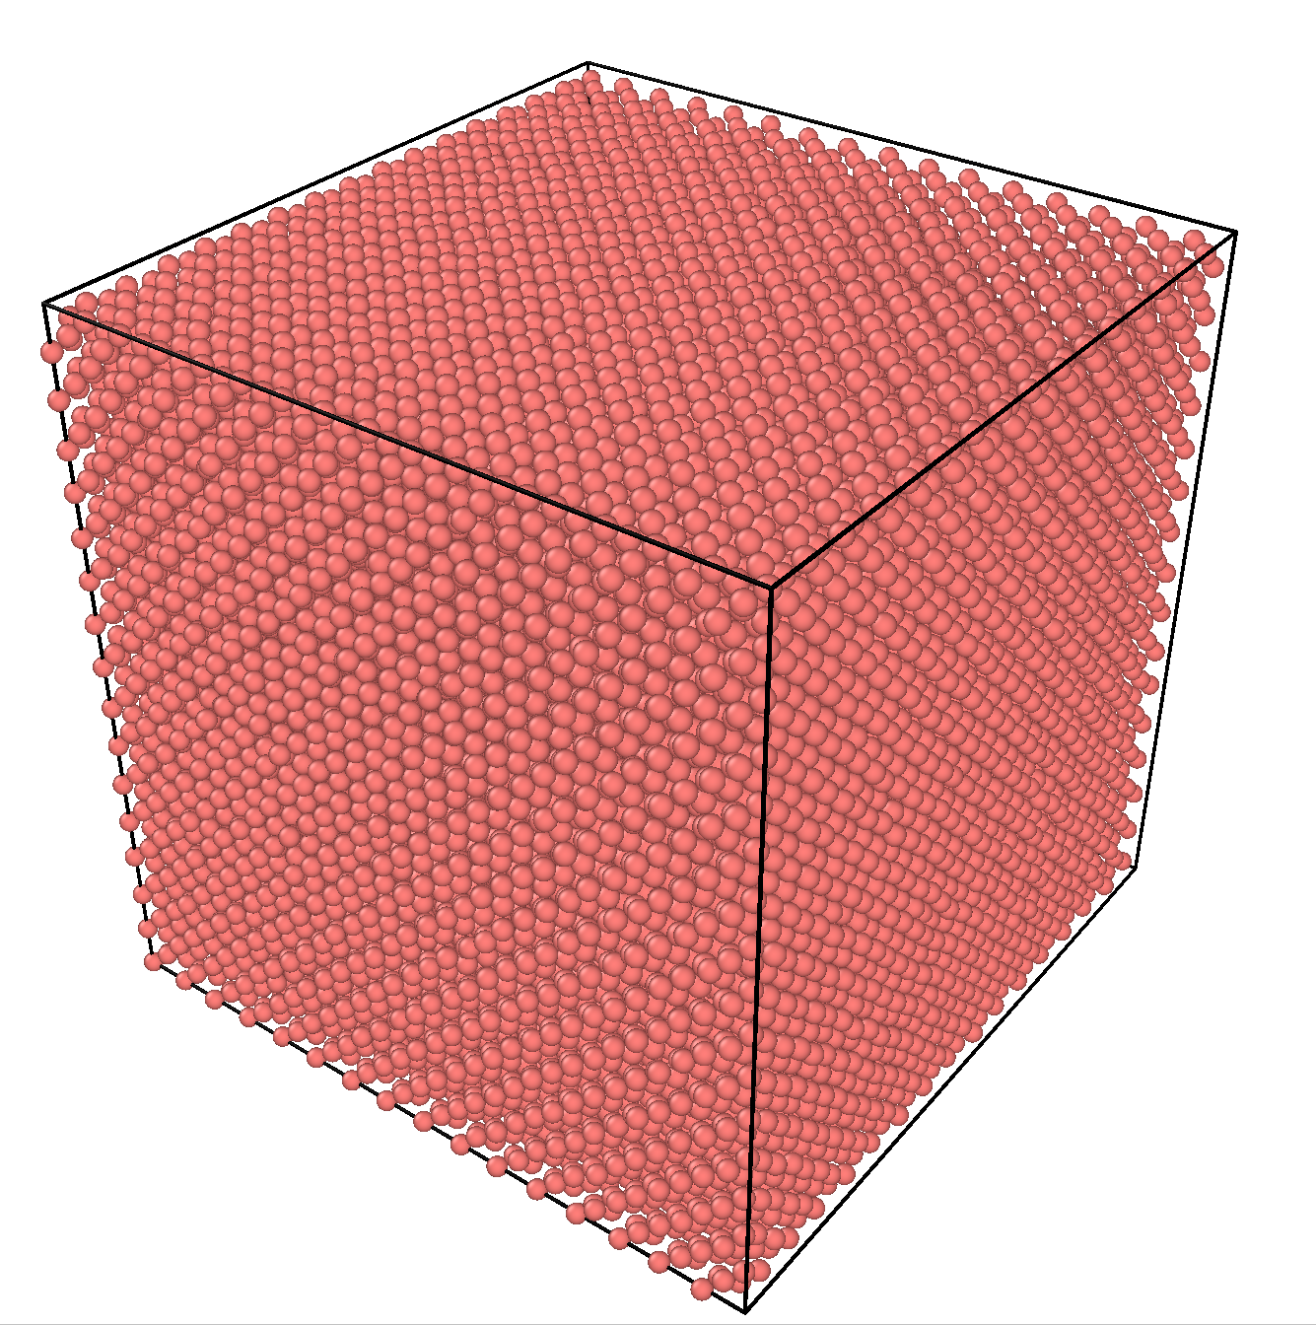
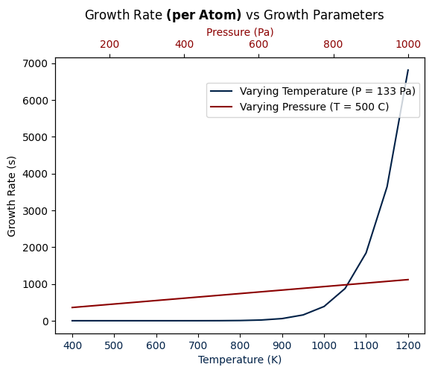
3.1 Growth Rate vs Growth Factors
Modelled 64x64x64 system of arrays: 4096 unit cells
Pressure is constant → Growth rate scales exponentially with temperature
Temperature is constant -> Growth rate scales linearly with partial pressure
Growth rate equation:

Slide 23

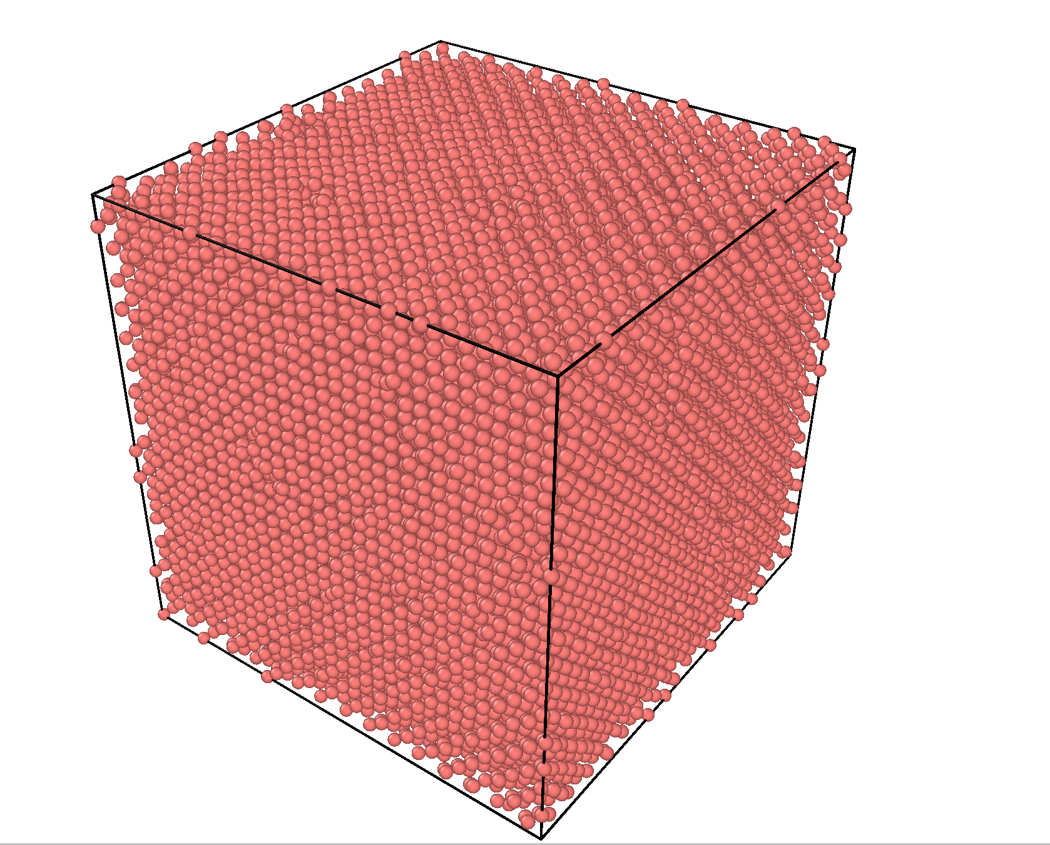
3.2 Defects in Epitaxial Silicon
Modelled three 64x64x64 systems of arrays: 4096 unit cells
(1) No defects
(2) 5 defects per layer
(3) 10 defects per layer
(images at equilibrium → atom locations change between systems 1 - 3)

Slide 24
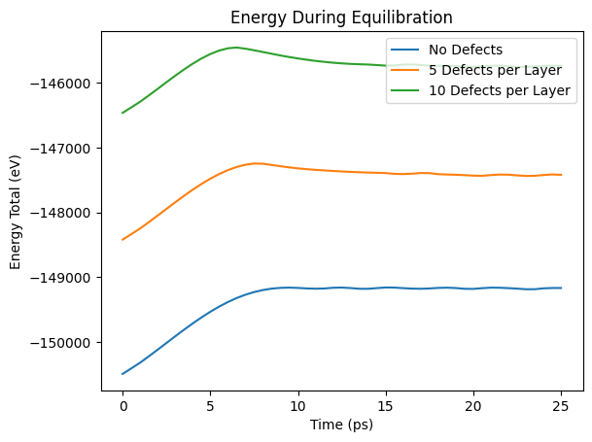
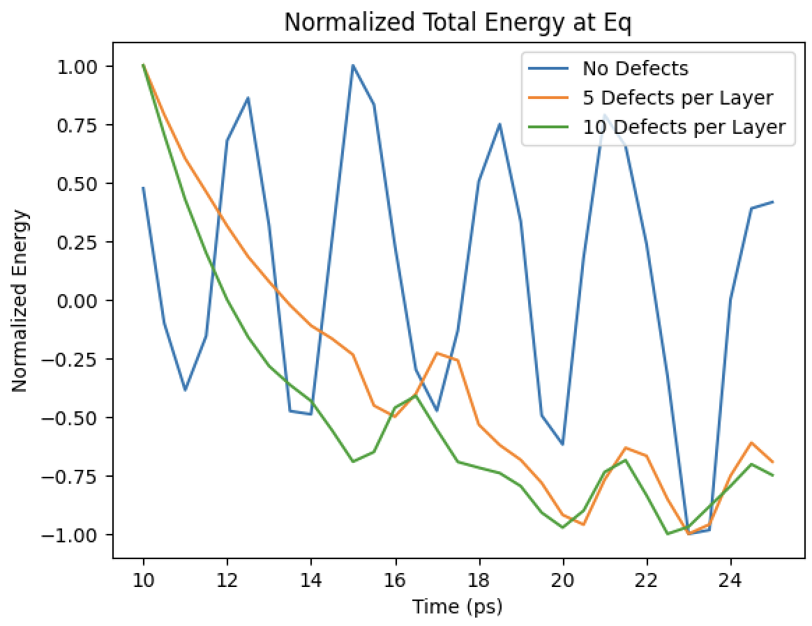
3.3 Effect of Defects on Energy
Total Energy
During equilibration: ↑ atoms = ↑ attraction (PE) in system
At equilibrium (normalized): ↑ defects = less stable oscillations

Slide 25
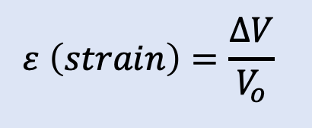
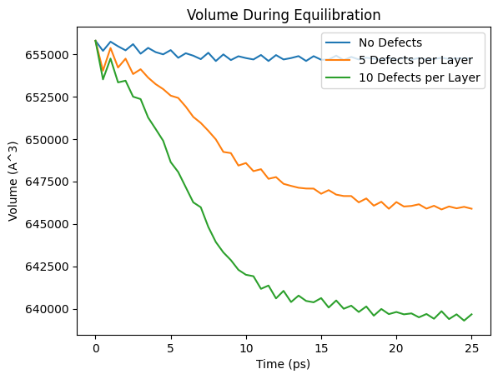
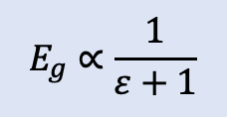
3.4 Effect of Defects on Volume
Volume
Understand how much added defects strain the system through ΔV
Defects per Layer | 5 | 10
Strain (%) | – 0.115 % | – 0.229 %
ΔV (10 defects)
ΔV(5 defects)
Strain increases linearly with defects
Energy gap ↑ with ↑ defects:
Device is less
efficient; requires
more to jump the
band gap [4]

Slide 26
4. Discussion

Slide 27

4.1 Application: Annealing Process Optimization
Annealing: after epitaxial Si is grown, high temperatures are applied (600 - 1000 ℃) to stabilize lattice, relieve stress, and reduce defects
Simulate in LAMMPS:
NPT equilibrium (room temp.)
Ramp up temp. (1000 K)
Ramp down temperature (room temp.)
NPT equilibrium again
Application: optimize annealing times and temperatures based on defects
(un-optimized)
a.
b.
c.
d.

Slide 28


4.1 Application: Annealing Process Optimization
Comparing pre-annealing energy to post-annealing energy at equilibrium:
(1) No defects: magnitude of energy ↓ post-anneal = ↑ stability
(2) 10 defects per layer: magnitude of energy ↑ post-anneal; vacancies filled = ↑ attraction (PE) in system

Slide 29

4.2 Challenges During Implementation
Monolayer deposition:
Growth of atoms depends only on layer directly below: produces not realistic, unstable structure
Ex: growing on 3rd layer → can’t fill vacancies on 1st
Equilibration in LAMMPS shows instability in structure with many vacancies

Slide 30

4.3 Simulation Limitations in kMC
Simplifying Assumptions
No annealing effects can occur during deposition
No atom migration -> fixed atom placement
Growth equation doesn’t account for changes in activation energy over deposition
Final growth rate values inaccurate → models used to show bulk material trends

Slide 31
5. Conclusion

Slide 32
5. Conclusion
Thank you! Questions?
kMC Epitaxial Growth
Environmental Factors
LAMMPS Analysis
Stability + Annealing Properties
LAMMPS Analysis
Physical Properties
Defects per Layer | 5 | 10
Strain (%) | – 0.115 % | – 0.229 %
No defects
10 defects per layer

Slide 33
References
[1] Semiconductor Engineering, "Epitaxy." Available: https://semiengineering.com/knowledge_centers/manufacturing/process/epitaxy/.
[2] Congressional Research Service, "Critical Minerals and U.S. Supply Chains." Available: https://crsreports.congress.gov/product/pdf/r/r47508.
[3] P. Pongratz, "Epitaxy of Semiconductor Compounds," in Lecture Notes in Physics, vol. 58, Springer, 1975, pp. 95-126. Available: https://link.springer.com/chapter/10.1007/978-3-7091-0382-1_4.
[4] ScienceDirect, "Strained Silicon." Available: https://www.sciencedirect.com/topics/materials-science/strained-silicon.
[5] Monolithic 3D, "Obtaining Monocrystalline Semiconductor Layers for Monolithic 3D." Available: http://www.monolithic3d.com/blog/obtaining-monocrystalline-semiconductor-layers-for-monolithic-3d.

Slide 34
References
[6] University Wafer, "Epitaxial Silicon Wafer." Available: https://www.universitywafer.com/epitaxial-silicon-wafer.html.
[7] ScienceDirect, "Assessment of Strain in Thin Films," Energy Procedia, vol. 102, 2016, pp. 640–645. Available: https://www.sciencedirect.com/science/article/pii/S1876610216305276.
[8] W. C. Dash, "Effect of Stresses on Quantum States in Germanium and Silicon," Journal of Applied Physics, vol. 43, no. 5, 1972, pp. 2027-2032. Available: https://www.sciencedirect.com/science/article/abs/pii/0022024872902539.
[9] M. T. Alam, "Silicon Thin Film Growth," Purdue University ECE Technical Reports, Paper 205. Available: https://docs.lib.purdue.edu/cgi/viewcontent.cgi?article=1205&context=ecetr.
[10] J. Wang et al., "Thermal Stability of SiGe Thin Films," Thin Solid Films, vol. 589, 2015, pp. 16-21. Available: https://www.sciencedirect.com/science/article/pii/S0040609015006902.
[12] LAMMPS Tube, "Minimization of Energy." Available: https://lammpstube.com/2020/08/05/minimization-of-energy/.

